Slide 1
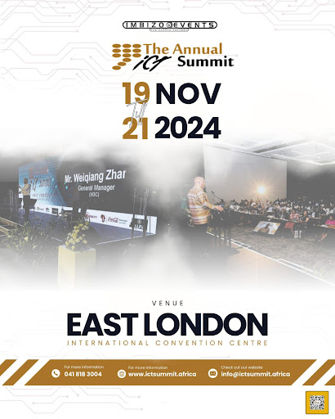
SUBMARINE CABLES AS DRIVERS OF DIGITAL TRANSFORMATION AND BOOSTING THE DIGITAL DIVIDEND
20 November 2024

Slide 2
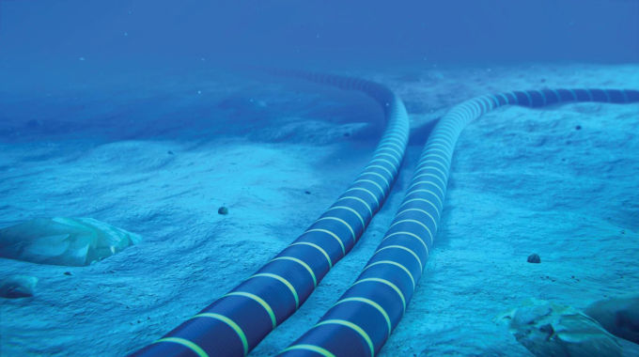

Slide 3
About Us
The Maritime Business Chamber (MBC) is a registered Non-Profit Company (NPC) with the aim to address the imbalances and opportunities in the Maritime Industry representing the interests of all businesses and associations currently and wishing to participate in the sector.
The Chamber is strategically aligned with the Operation Phakisa, Comprehensive Maritime Transport Policy (CMTP), South Africa’s Oceans Economy Master Plan and the IMO Maritime Policy for sustainable maritime and determined to align itself with the maritime global commitments.
The Maritime Business Chamber (MBC) supports all national, regional and international Maritime programmes that seeks to promote sustainability (balance socio-economic and environmental issues in the Maritime industry).

Slide 4
Vision and Mission
VISION:
‘To be a be a leading, inclusive, progressive and transformative chamber for the development of competent and sustainable maritime enterprises’
MISSION:
‘To be a leading partner in offering maritime services that promote socio-economic growth and maritime industry capacity building.’
MOTTO:
Maritime for US ALL!

Slide 5
The Maritime Business Chamber (MBC) Objectives are:
POLICY: To advocate for policy matters that seeks to address the issues of participation for historically disadvantaged businesses due to legislation and regulations that are biased and one-sided.
ENTERPRISE DEVELOPMENT: To facilitate networking opportunities for maritime enterprises and encourage soft landings and develop maritime industry value chain for broader economic participation; To contribute to the growth (jobs and GDP) and wealth creation by promoting, developing and expanding entrepreneurship;
GLOBAL COMPETITIVENESS: To build a globally competitive chamber and ensure representation of SA maritime sector at a global level. To establish practical linkages and a global network to reduce over-reliance to local institutions.

Slide 6
MBC Objectives are: (Cont.)
ADVOCACY: To facilitate and advocate for accreditation/industry compliance for its constituency; To advocate for policy matters addressing participation for historically disadvantaged businesses due to legislation and regulations that are biased and one sided; To champion the awareness and the promotion of the Maritime Sector by cooperating with partners and stakeholders within the broader Maritime sector both public and private.
ACCESS TO FINANCE: To facilitate the procurement processes to reach the end of the value chain in the bottom line; To facilitate technical support through stakeholder partnerships; To build a market intelligence bank that will seek to stand as a surety for the disadvantaged. (Access to finance for members and sustainability of the chamber)

Slide 7
CHAMBER OPERATIONS

Slide 8
ENABLERS
Corporate Governance and Monitoring
Media and Communication
Innovation and Technology
Training and Education
Occupational, Health and Safety
Research and Development
Transformation and Localization
Business Support
Policy and Regulation

Slide 9
SECTORS OF FOCUS
Shipping Transport
Maritime Logistics and Infrastructure
Off-shore Energy and Mining
Shipping Logistics
Marine Technologies
Ports, Marine Services and Coastal
Marine & Civil Engineering
Fisheries, Pharmaceuticals and Aquaculture
Marine Leisure, Boating and Cruising
Sports and Recreation

Slide 10
CORPORATE MEMBERS AND ASSOCIATE MEMBERS
Some of our Corporate Members:
Our Associate Members:

Slide 11
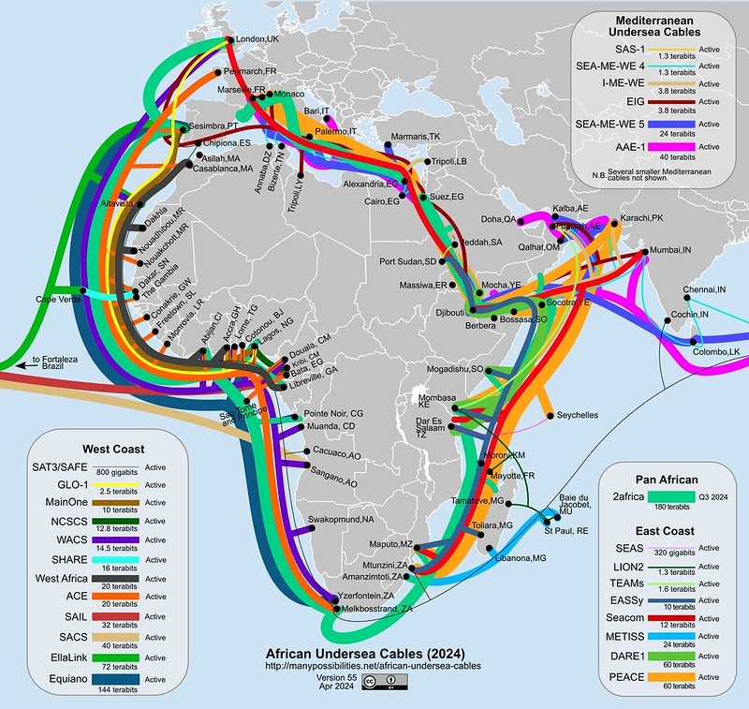
Submarine cables as drivers of digital transformation and boosting the digital dividend

Slide 12
The Digital Divide
As defined by the Organisation for Economic Co-operation and Development (OECD)
The term digital divide ‘refers to the gap between individuals, households,
businesses and geographic areas at different socio-economic levels with regards to
both their opportunities to access information and communication technologies
(ICTs) and their use of the internet for a wide variety of activities.
Over 3.7 billion people in low- and
medium-income countries are without internet access. Yet access to connectivity, under-
pinned by adequate and affordable infrastructure as well as digital skills, is paramount if
these countries are to participate fully in the digital economy and rebuild their economies

Slide 13
The Role of the Subsea Cables
Subsea cables play a critical role in modern global communications, energy transfer, and data exchange.
These cables, which are laid on or beneath the ocean floor, enable vital infrastructure that connects continents and facilitates a wide range of economic, technological, and energy-related activities.
Their primary applications include telecommunications, internet connectivity, and subsea power transmission.
Subsea cables are a foundational element of global connectivity, enabling everything from international data exchange and internet browsing to energy transmission and infrastructure security.

Slide 14
How Can Subsea Cables Boost the Economy
Subsea cables can significantly boost the global economy in multiple ways, particularly through:
Enhancing communication
Facilitating trade
Improving energy distribution
Enabling technological advancements.

Slide 15
Opportunities for Local Businesses
Local businesses can tap into a variety of opportunities related to the growing subsea cable industry.
As the global demand for faster internet, reliable data transmission, and renewable energy infrastructure continues to rise, local businesses can find ways to participate in this rapidly expanding sector.
These opportunities span across different industries, from construction and logistics to technology, maintenance, and security.

Slide 16
Opportunities for Local Businesses Cont.
Below are some key opportunities for local businesses to tap into:
Marine and Offshore Construction
Maintenance and Repair Services
Logistics and Supply Chain Services
Technology and Data Services
Energy Sector Involvement
Consulting and Project Management
Marine and Environmental Services
Training and Certification
Security and Surveillance Services

Slide 17
Maritime Business Chamber (MBC)
Maritime Chamber House
211 Walmer Boulevard
South End
Eastern Cape
Tel: +27 (0) 41 587 5855
Mobile: +27 (0) 82 516 4618
Email: adminoffice@maritimechamber.co.za
Web: www.maritimechamber.co.za
SM:
Maritime for Us ALL!

